Slide 1
Solar with THRYVE
Let’s build your best life.
Notes:
Welcome Slide
Present this slide show after conducting Discovery right after completing the Solar Explorer Guide. Use a transitional statement to guide the conversation towards why your customer should choose you, your company and THRYVE products to meet their energy need. For example: “Now that we have discovered what your needs are, let’s review how we can meet those needs”.

Slide 2
[Dealer Name]
Your Neighborhood Solar Specialist
Add what your company does well,
what sets you apart,
how long you’ve been in business,
etc.
Add your logo and an image of your team
Notes:
Energy Consultant and Dealer Introduction
(Energy Consultants should fill this slide in with their company information, images and highlights)
Explain who you are, how long you have been in solar and what you will do for them as their energy consultant - sell yourself, what makes you different.
Explain who your company is, and pertinent details on what makes your company great and different from the competition.
Transition statement to next slide. “Now that you know about me and my company let tell you about our solar products”.

Slide 3
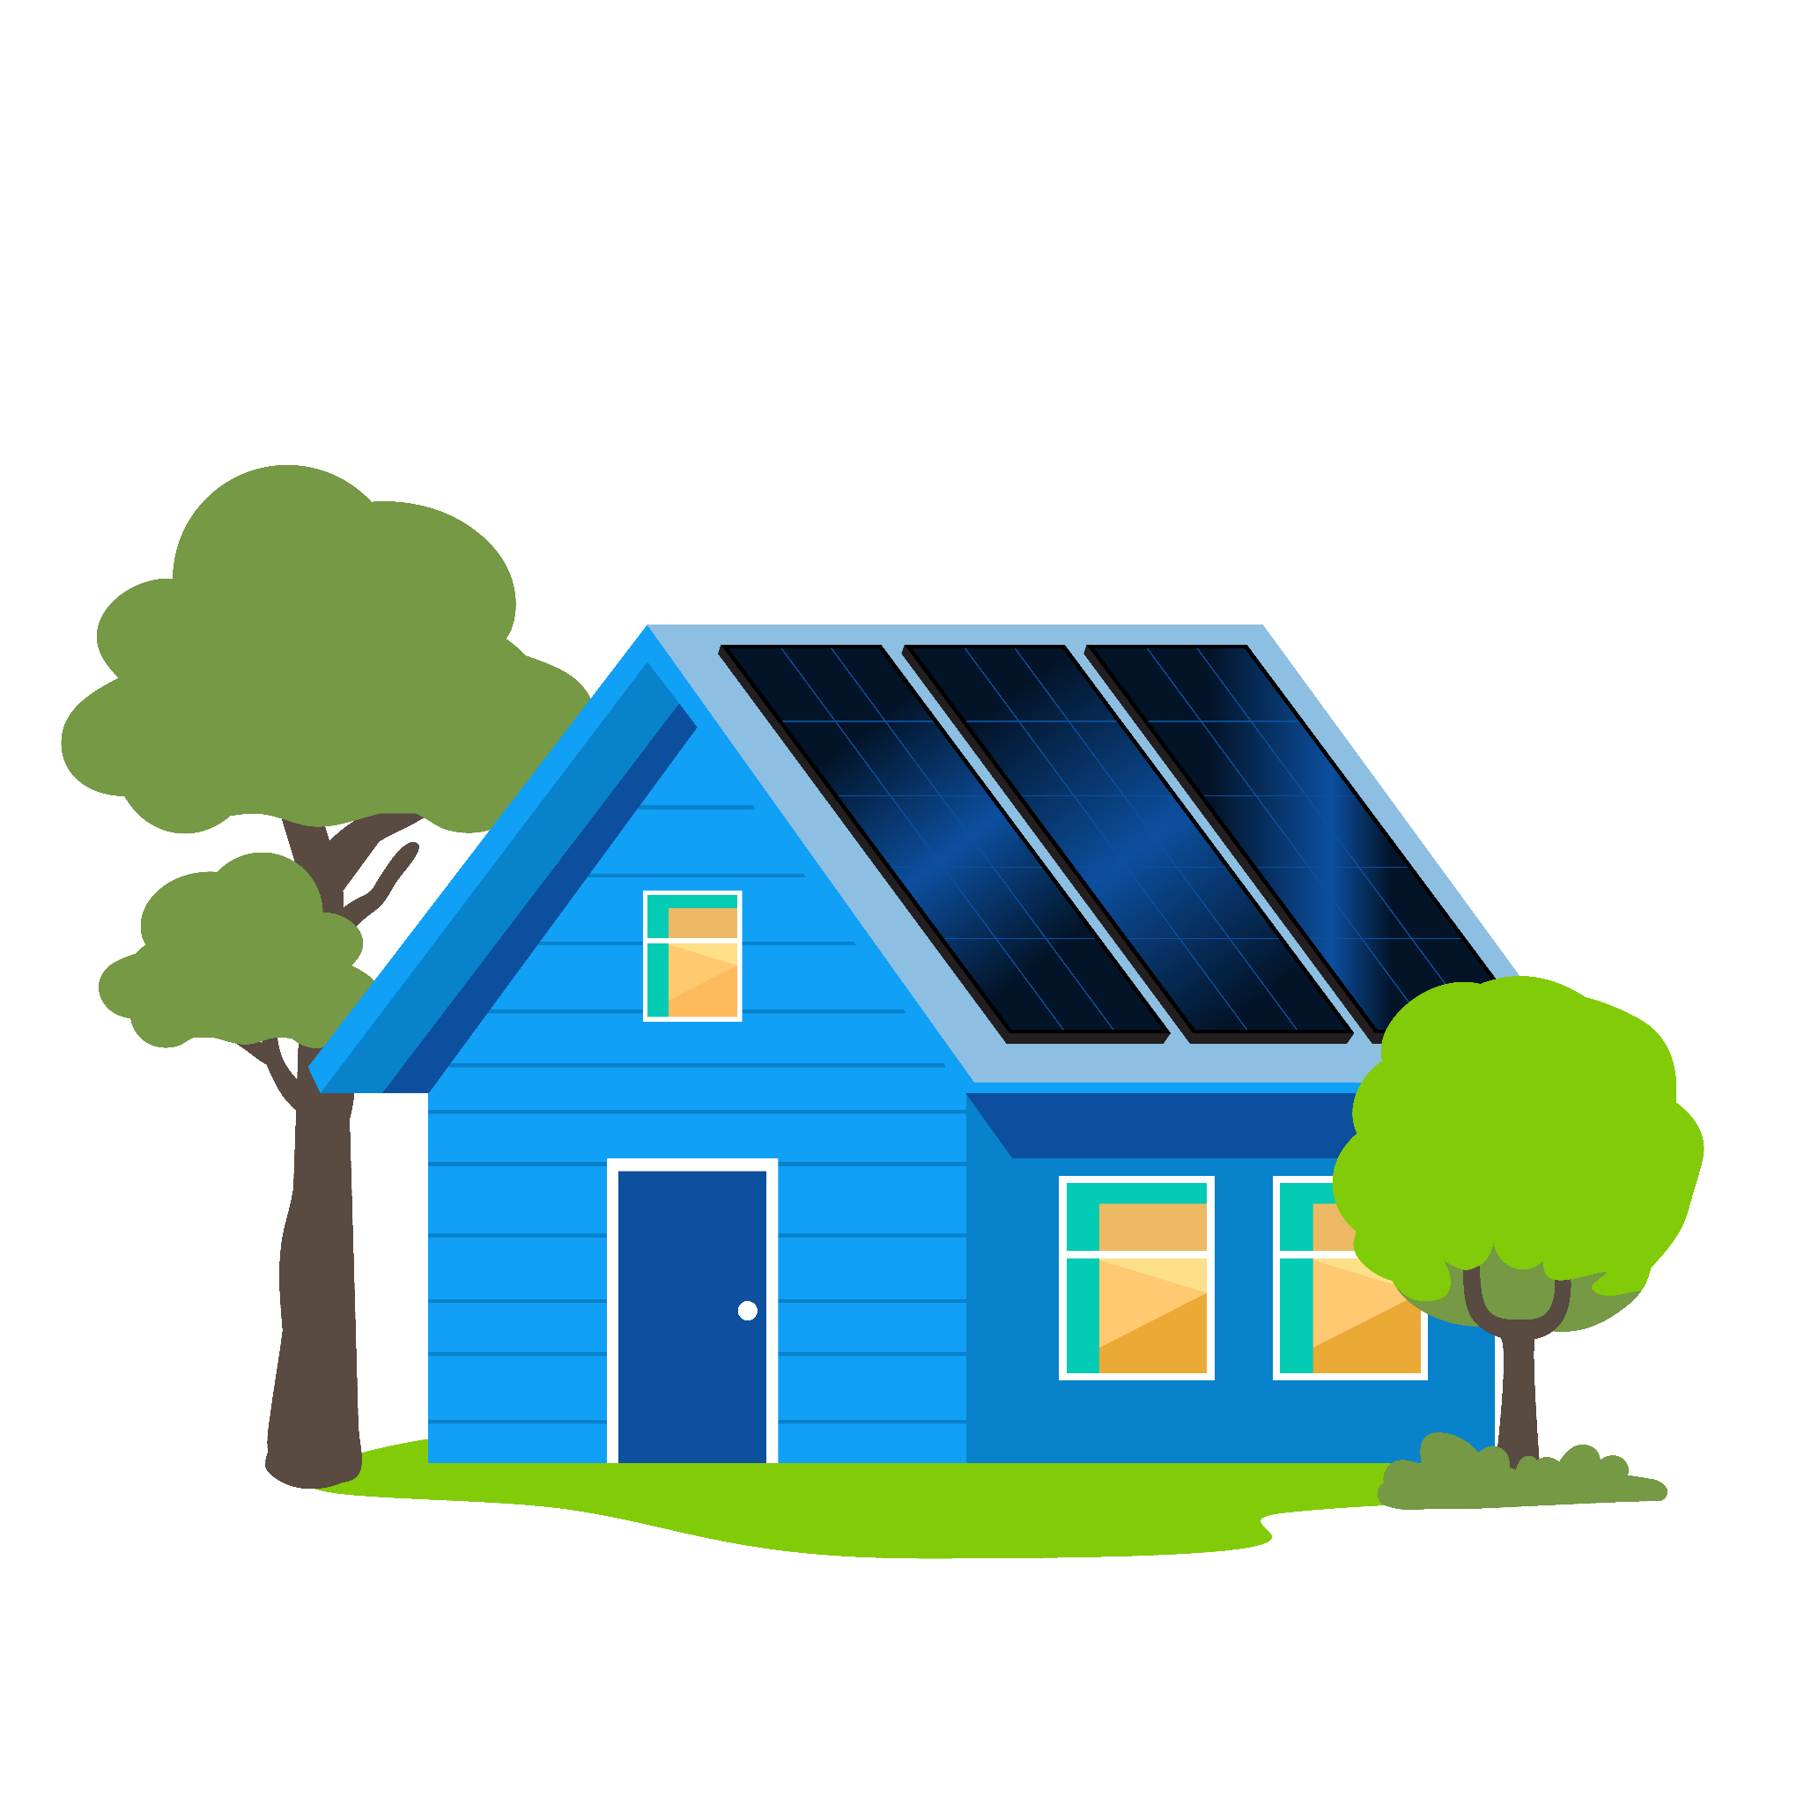
Lineup of Products
Made in America
Differentiated + unique
Speedy replacement for all components
Domestic Content incentives
Racking
Solar PV panels
Monitoring
Inverters w optimizers
Storage
Notes:
American-Made System
One of the most exciting aspects of our product offering is that we offer only American made products. Solar panel options, SolarEdge inverters and storage with an awesome monitoring platform all secured to your home using industry leading Pegasus or UniRac mounting systems.
Let’s take a look at each component.

Slide 4



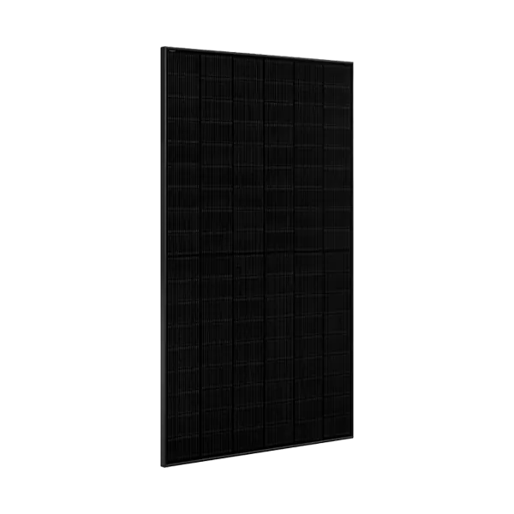
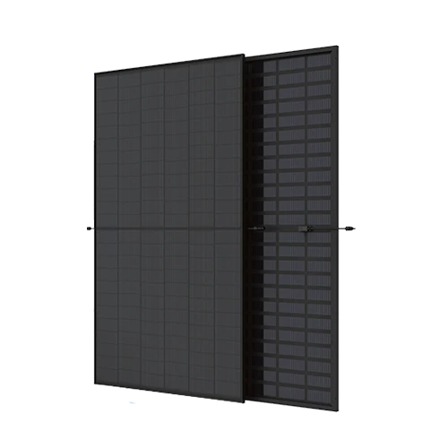
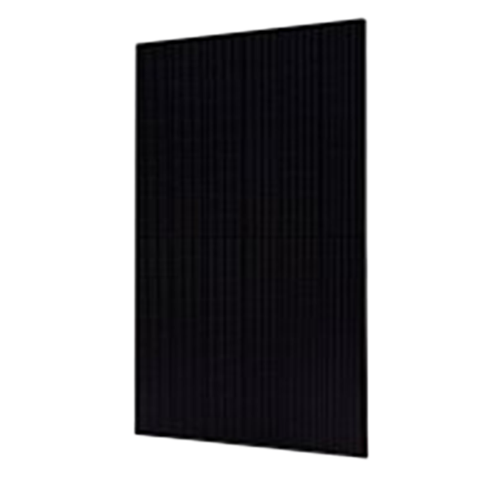
PRODUCTS
Solar Panels
405-440 watt panel options
25-year warranty
Sleek, all-black design
High Efficiency
Rock-solid reliability
Surpass industry standards
Low degradation
21% High efficiency
All-black panel
High Efficiency up to 22.5%
Double-sided sun capture
Low degradation
High Efficiency up to 21.3%
Better shade performance
Better performance in heat
High Efficiency up to 21.25%
Minimizes shade impact
Bifacial reflective boost
Notes:
Solar Energy Panels - [Note: Don’t bog customers down with technical talk unless they ask.]
[Provide Mission Data Sheet if requested.]
Our product lineup kicks off with solar panel options, proudly made in the USA. These panels aren’t just high-quality—they’re powerhouses, delivering top-notch output and rock-solid reliability. Whether you’re powering up your home or your business, we have you covered with panels that surpass industry standards and keep performing year after year. With THRYVE, you’re not just going solar, you’re going big, with Texas-sized energy and a whole lot of sunshine!
Key highlights: Not subject to tariffs which saves you money
JA Solar 405 watt panel
Half-Cell Configuration: Uses 11BB PERC cells in a half-cell layout that reduces internal resistance, improves shade tolerance, and minimizes hot spot risk.
20.7% Module Efficiency: Helps maximize power generation within the available installation space.
Mechanical Load Capacity: Tested to withstand up to 5400 Pa front load and 2400 Pa rear load.
Low Annual Degradation: With just 0.55% annual degradation after the first year, the panel maintains higher output over its lifetime compared to standard modules.
Uniform Black Appearance: Module features black cells, black backsheet, and black frame, providing a consistent appearance that complements most building designs.
JA Solar 440 watt panel
Reliable Performance: 2N-type with lowed LID. better temperature coefficient, wakes up earlier
22% Module Efficiency: Helps maximize power generation within the available installation space with a higher power yield.
Durable: Tested to withstand up to 5400 Pa front load and 2400 Pa rear load. Ideal for installations in areas prone to heavy snow or strong winds
Low Annual Degradation: With just 0.4% annual degradation after the first year, the panel maintains higher output over its lifetime compared to standard modules.
Uniform Black Appearance: Module features black cells, black backsheet, and black frame, providing a consistent appearance that complements most building designs.
Trina Solar 410 watt panel
High Power Output: Delivers up to 410W of power, optimizing energy production in a compact form factor. 20.5% efficiency
Mono PERC Technology: Utilizes advanced Monocrystalline PERC (Passivated Emitter and Rear Contact) cells to achieve high efficiency and superior performance.
N-Type Cells: Features N-Type cells that provide excellent performance and lower degradation, resulting in a longer lifespan.
144 Half-Cell Design: The half-cell technology reduces resistive losses, enhancing performance, especially in partially shaded conditions.
Aesthetic and Durable: Built with durable materials and a sleek design, making it perfect for installations where appearance matters.
Trina Solar 425 watt panel
High Power Output: Delivers up to 425W peak power with a 21.3% module efficiency, maximizing energy generation.
Warm Weather Performance: Features a low temperature coefficient (-0.30%/°C) enhancing energy yield in higher temperatures.
Enhanced Reliability: Utilizes innovative non-destructive cutting for improved strength and boasts excellent weather and fire resistance ratings.
Ultra-Low Degradation: Ensures long-term performance with only 1% first-year degradation and 0.4% annual degradation thereafter.
Universal Compatibility: Designed for easy integration with existing mainstream inverters and various mounting systems for flexible installation.
Mono PERC Technology: Utilizes advanced Monocrystalline PERC (Passivated Emitter and Rear Contact) cells to achieve high efficiency and superior performance.
N-Type Cells: Features N-Type cells that provide excellent performance and lower degradation, resulting in a longer lifespan.
144 Half-Cell Design: The half-cell technology reduces resistive losses, enhancing performance, especially in partially shaded conditions.
Aesthetic and Durable: Built with durable materials and a sleek design, making it perfect for installations where appearance matters.
Sirius 415 watt panel
High Power Output: Delivers up to 415W of power. 21.25% efficiency
Performance: Low light performance. Less power loss by minimizing the shading impact
Durability: 5400 pa wind load and 5400 pa snow load
High Efficiency: Bifacial reflective boost provides more sunlight absorption and minimizes shading impact
Aesthetic: All-black module, making it perfect for installations where appearance matters.

Slide 5


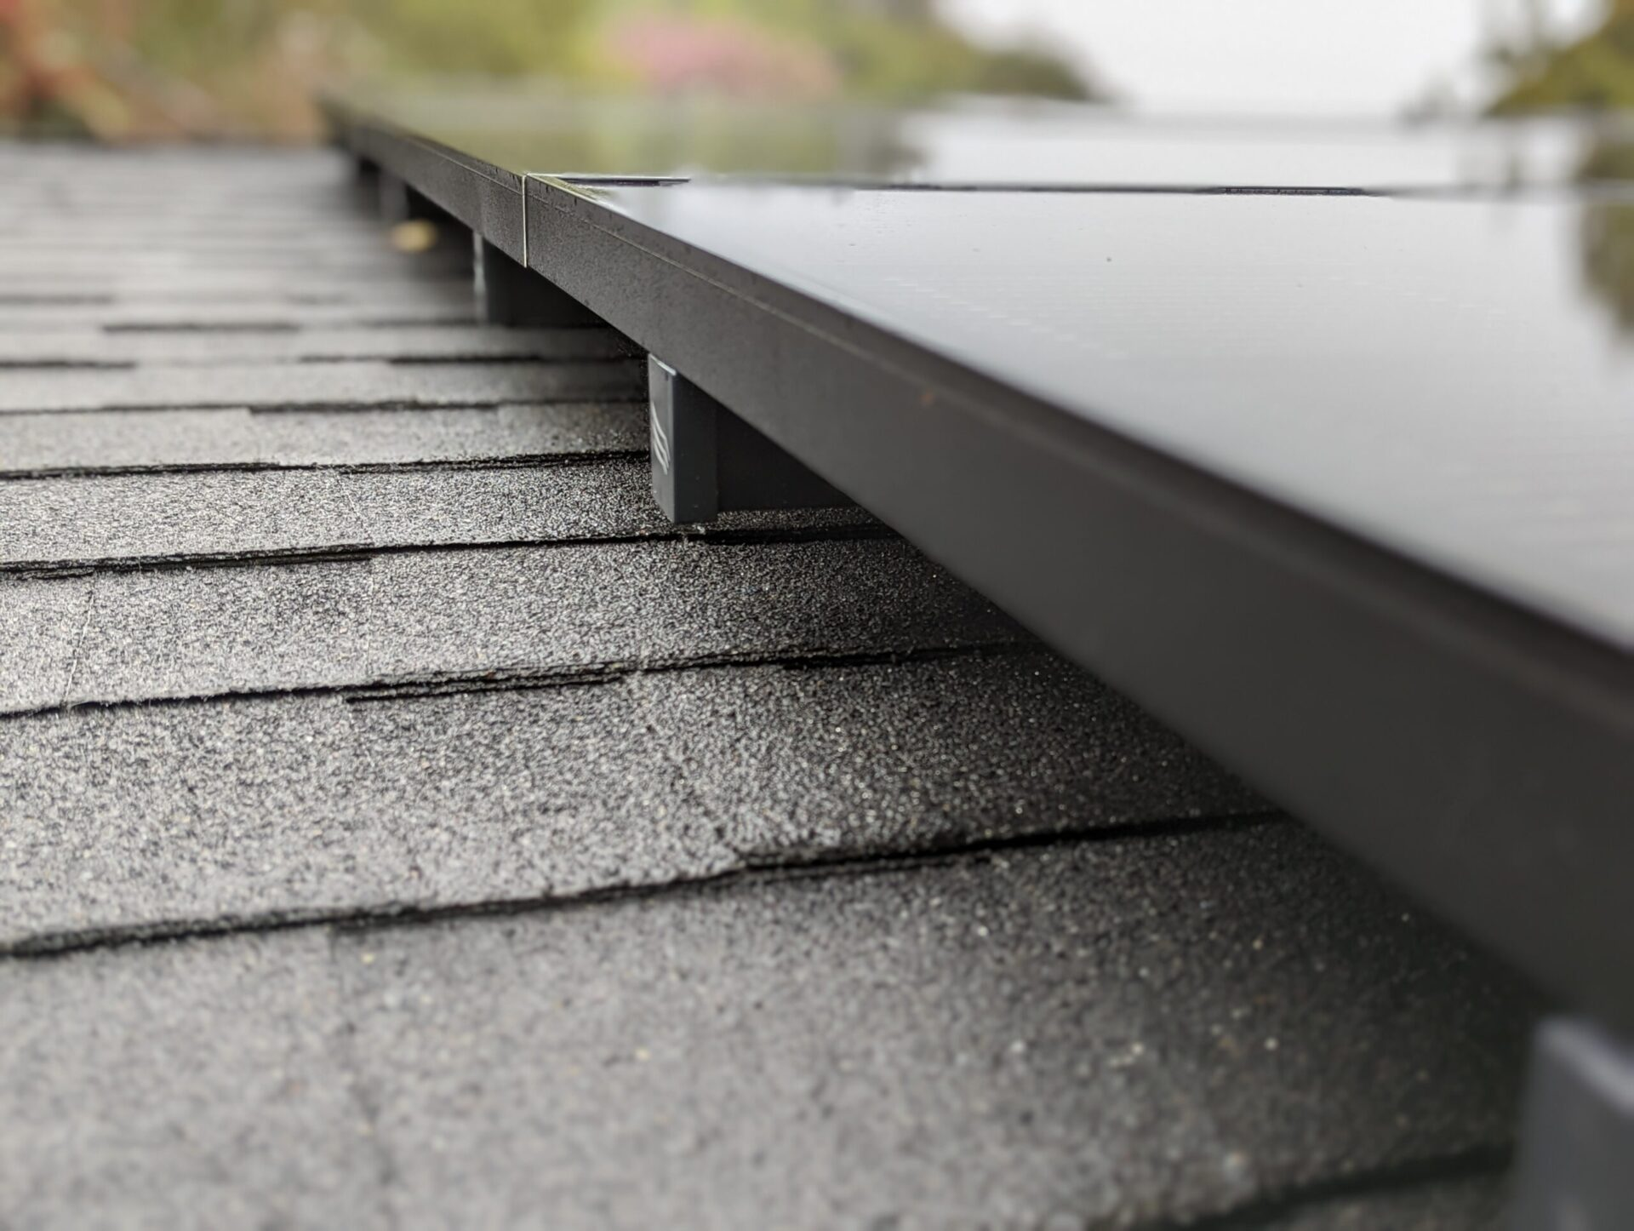
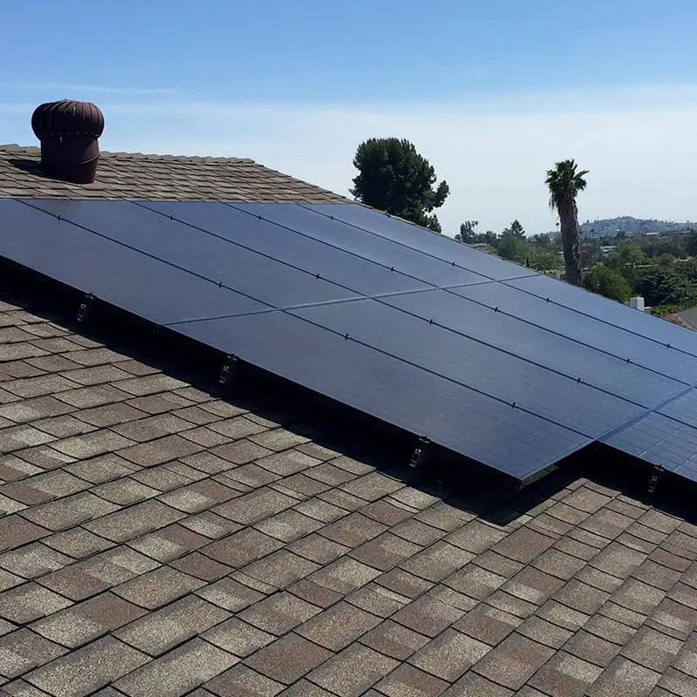
PRODUCTS
Next-generation mounting systems with high wind and snow load designs
Solar
Mounting
Best aesthetics with all-black finish & hidden hardware
Instant bonding
Hidden wire management
Installers are certified
Low Profile
Hidden hardware
Hidden wire management
Refined flush mounted profile
Concealed hardware
Seamless wire management
Notes:
Mounting System
We mount your solar panels on the roof with the newest next-level solar mounting systems from Pegasus and UniRac. They are superior for their ability to resist dramatic weather conditions. This durable American-made racking, is valued for its tough weight and wind loads. It’s known for its clean, attractive design, and easy installation, with a seamless look from your front yard. This industry leading mounting system comes with a warranty for 25 yrs.

Slide 6

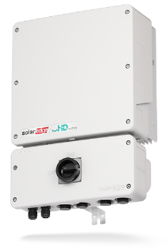
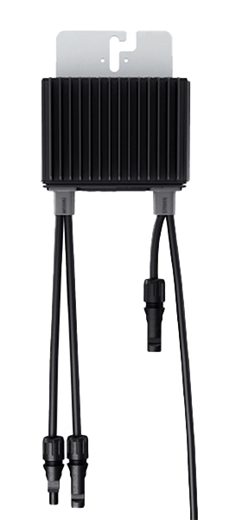
PRODUCTS
Inverters
with Optimizers
The SolarEdge single-phase inverter is specifically designed to work with SolarEdge power optimizers.
#1 Award-winning inverter
25-year warranty
Module-level monitoring
High reliability
SolarEdge Power Optimizers enable each panel in the PV array to work independently.
25-year warranty!
Notes:
SolarEdge With Optimizers [Don’t bog customers down with technical talk]
You, as the customer, are receiving the newest model and best quality inverter provided by our manufacturer, SolarEdge. SolarEdge has a next to zero replacement failure rate at .0005, so that you never need to worry about your system producing the way it should.
Key Benefits:
#1 Award winning inverter
Integrated with power optimizers to maximize capturing power from the solar panel
Built-in module level monitoring that allows you to view the performance of each solar panel
Higher reliability due to a the ability to operate at a cooler temperature
Smaller and lighter than the standard inverters on the market today
25-year warranty covers labor, shipping, and parts.

Slide 7
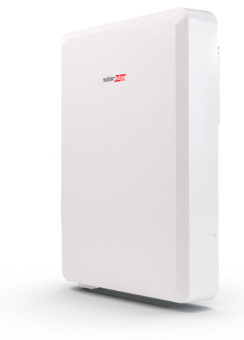
PRODUCTS
Battery
Up to 10 days of free power every year
25-year warranty without cycle limitations
Next-generation battery
25-year warranty!
Charge with solar
Increase your energy independence
Enjoy more solar savings
Notes:
SolarEdge Battery [Note: Don’t bog customers down with technical talk unless they ask.]
Let’s talk about storage options for your energy-independent home.
Have you considered storage?
Do you have an electric vehicle?
Do you experience power blackouts or storms in your area?
A battery gives you expanded access to the solar energy your system captures during the day. By storing excess solar energy not used by your home, you have control over more of your energy, not the utility company. Power your home when utility rates are high, at night, or during a blackout.
Storing energy helps you save money on your electric bill,
With the SolarEdge Battery, you…
Charge with solar
Increase energy independence
Enjoy more solar savings
Manage your solar, storage and smart energy device with one app
Power essential loads like lights, refrigerators and wi-fi during an outage
Comes with a 10-year warranty and unlimited cycles
Sleek design which allows installation closer to the wall
* This depends on the state - NEM 3.0 - certain states - If your state is not buying back your energy.
As your system generates electricity during the day, any unused energy is sent to your solar battery for later use. Store your clean, solar energy and use it to power your home when utility rates are at their peak, helping you save money on your electric bill.
A solar battery can enhance your electricity bill savings beyond what solar panels can achieve alone.
Note: The ability to power devices during outages varies depending on the battery’s capacity, energy usage, recharge rates, and other factors. The battery storage system is not intended to serve as a sole power source for critical medical devices.

Slide 8
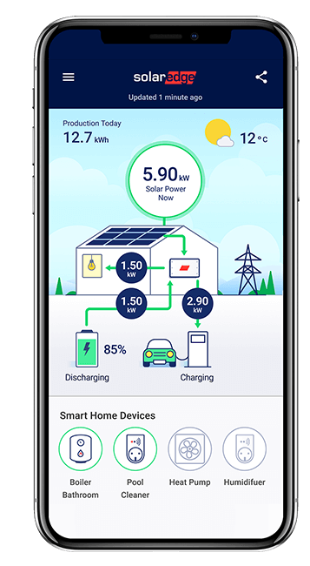
PRODUCTS
Monitoring
Homeowner-facing app
Real-time solar production
Load consumption down to single appliances!
LCD screen installed in home
mySolarEdge® app
25-year warranty!
Notes:
Monitoring (video showing monitoring) NAM-SolarEdge-Home-mySolarEdge-App.mp4
Monitor your system’s performance and energy consumption with real-time power flow illustrations, comparative graphs, and easy-to-read charts conveniently in your phone via an app.
Change your battery settings, schedule EV charging. prioritize critical loads and more from your phone
Monitor how your home consumes energy so that you can shift your consumption to times when solar energy is available or when grid rates are lowest.
See energy production and consumption and get real-time illustrations of your energy flow as well as historical data to help you maximize your energy production and usage.
NOTE: only with home battery backup. Designed exclusively for SolarEdge system owners with home battery backup, the Weather Guard feature can be found in the mySolarEdge app. When enabled, it detects severe weather and is designed to automatically charge your battery to full capacity before the grid goes down, so you can stay powered longer.

Slide 9
25-Year Warranties
All solar energy panels
SolarEdge® inverters
Pegasus® mounting
UniRac® mounting
Notes:
25-Year Warranty
THRYVE Solar panels, are backed by a 25-year warranty, including shipping and labor, along with a 12-year roof penetration warranty. For added peace of mind, we provide a 90% performance guarantee where applicable (excluding Florida).
THRYVE SolarEdge Inverters come with a THRYVE exclusive full 25-year warranty. The standard warranty is 12-years but buying from THRYVE extends it to a full 25 years, that is value! In the event something happens THRYVE partners have access to replacement shipping in 24-48 hours.
Our solar mounting options have a manufacturer’s warranty of 25 years, including cable management hardware.

Slide 10
Whether buying power or buying the system, you are reaping the benefits.
Locking in the cost of electricity for 25 years+
Investing in your home
Lowering your utility bill
Buy Your Power
Buy Your System
No out-of-pocket costs No responsibility of ownership Monitoring for system performance |  | Eligible for incentives and tax credits Monitoring app available
Transfer or buy the system at sale of home Renew, buy, or remove at end of term |  | Upgrade to an energy efficient home and increase your home marketability
Notes:
Before looking at the price tag and wondering how to pay for it…
…remember, you are locking in the cost of electricity for the next 25 years and beyond!
As utility prices rise year after year, you’ll be taking advantage of lower utility bills and fixed payments.
Not to mention you are investing in your home. Your solar home is automatically more marketable in today’s real estate market.
Have you decided how you want to pay for your solar system?
Do you want to buy the power or the system?
Would you like me to explain the difference between buying power and buying the system?
Buying Power: (Lease/PPA)
You can get the solar system with no upfront costs and no installation fees.
A third party would own the system and you’d pay a fixed monthly fee to use the energy produced.
No responsibility of ownership. We are responsible for maintenance and repairs.
We also monitor the system’s performance during the lease term.
25-lease term, with option to buy, renew, or remove at end of term.
Lease can transfer or be purchased to include in sale of home
Buying the System: Cash/Loan
If you purchase the system, you may be eligible to receive solar incentives and the Federal tax credit.
Also, you home marketability is increased with the addition of solar.
Note: Presentation can end here. The next slide is the solar journey timeline, and could be presented later once the customer says yes to solar.

Slide 11
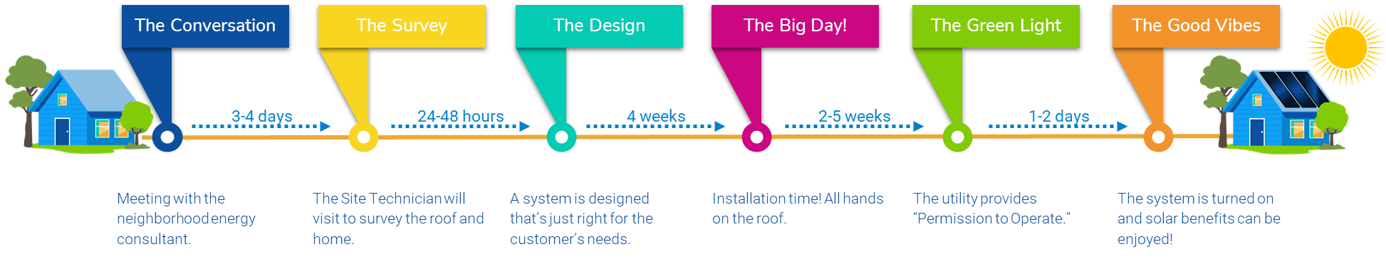
Your Solar Journey
Here are the milestones on your path to sunshine. It’s as easy as flipping a switch.
Notes:
You may want to wait on this slide until you have closed with the customer.
You can present this during the signing to set expectations on the timeline.

